Slide 1
Measuring Networks at the Individual Level

Slide 2
Where does network data come from?
Surveys
  You ask people about their relations
    Best approach for the collection of ego network data
      Next class!
Direct Observation
  You go to a site and record interactions between people
    Classrooms
    Neighborhoods
    Karate Club
    Monastery
    Frat House
    Beach?

Slide 3

Ego (personal) networks
Sometimes the best way to figure out who a person is connected to is to ask them!
  This yields personal (ego) networks
  Information on:
    Ego (the individuals)
    Role, exchange, interaction relations between ego and a set of alters
    Relations among the alters from the point of view of ego
    Properties of each relation from the point of view of ego

Slide 4
Types of ties in ego networks
Role relations (states)
  Friends, kin, business partners
Interpersonal sentiments and cognitions
  Liking, trusting, acquaintanceship
Behavioral Social Interactions
  Calling, texting, citing, supporting, resource exchange

Slide 5
Measuring ego networks: Four steps
Pick a type of relation you are interested in
  This defines your name generator
Pick a maximum number
  E.g. 5-20
Pick a set of alter and tie-level characteristics you are interested in
  This defines your name interpreter
Collect information about relations between alters (optional)

Slide 6
Name generators: Four approaches
Role-Relation Approach
  Neighbors, friends, kin, co-authors
Interaction Approach
  Frequency, duration of contact
Affective Approach
  Significant, close, enemies
Exchange Approach
  Information, favors, support, resources
    Different approaches can produce ego-networks with different structural characteristics!

Slide 7
Name generators: Four approaches
Role-Relation Approach
  “list the names of up to [X] [friends, co-workers, co-authors, pub-mates, etc.]”
Interaction Approach
  “list the names of up to [X] of the people you most frequently interact with
Affective Approach
  “list the names of up to [X] of the people you [feel closest to, trust most, etc.]”
Exchange Approach
  “list the names of up to [X] of the people you would go to for [advice, financial support, etc.]

Slide 8
Name generators: Four approaches
Famous examples:
  Wellman’s (1979) East York Study:
    “Name the six persons outside your home that you feel closest to.”
  Fischer’s (1982) Northern California Communities Study:
    “Name all persons who would provide any of eight types of aid”
  Marsden’s (1987) General Social Survey:
    “Named all persons with whom you have discussed matters important to you”

Slide 9
Name generators: Four approaches
Role-Relation Approach
  Problem: low reliability, cultural specificity issues, cross-respondent heterogeneity in label interpretation (what is a “friend”?)
Interaction Approach
  Less validity issues than role-relations, but frequency does not equal importance/closeness (needs to be combined with other approaches)
Affective Approach
  Same reliability issues as role-relation items but useful for eliciting strong or subjectively significant ties; elicits smaller networks
Exchange Approach
  Less reliability problems, useful for social capital studies, but not appropriate for all purposes; can capture weak ties and larger number of alters

Slide 10
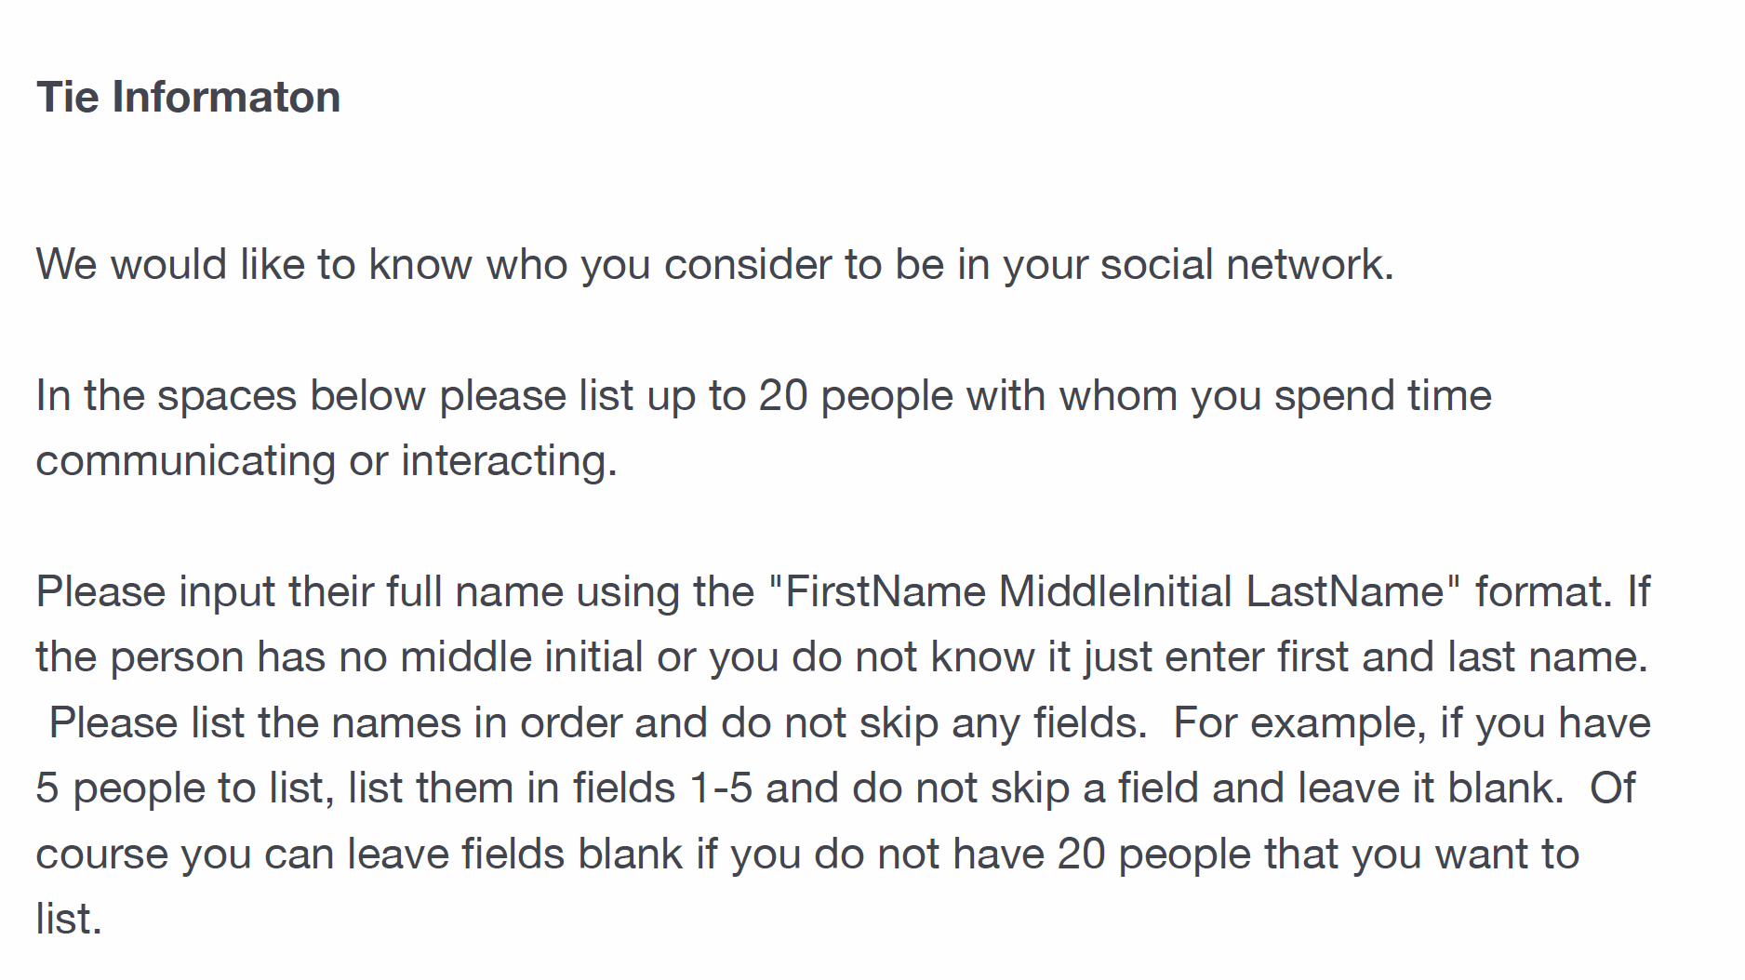
Name generators: Four approaches
What’s the best approach?
  Kitts (2014) recommends a “most-neutral” criterion (e.g. interaction frequency) for eliciting names
    Then use name interpreters to get a roles, exchanges, sentiments and so on
Example:
  NetSense Study
  NetHealth Study

Slide 11

Name interpreters
Follow up questions designed to get information on named alters
  Socio-demographic characteristics of alter
    Gender
    Age
    Race
    Years of Education
    Relationship to the organization
    Religion
    Etc.

Slide 12

Name interpreters
Follow up questions designed to get information on named alters
  Socio-demographic characteristics of alter
    Sex/Gender
    Age
    Race
    Years of Education
    Relationship to the organization
    Religion
    Etc.

Slide 13

Name interpreters
Follow up questions designed to get information on named alters
  Socio-demographic characteristics of alter
    Gender
    Age
    Race
    Years of Education
    Relationship to the organization
    Religion
    Etc.

Slide 14

Name interpreters
Follow up questions designed to get information on named alters
  Socio-demographic characteristics of alter
    Gender
    Age
    Race
    Years of Education
    Relationship to the organization
    Religion
    Etc.

Slide 15

Name interpreters
Follow up questions designed to get information on elicited relations
  Role-relations
    Friends, co-workers, co-authors, pub-mates
  Sentiments
    Loving, exciting, significant, negative sentiments (difficult person)
  Exchanges and Support
    Advice, would go to for financial help, discuss important matters, etc.

Slide 16

Name interpreters
Follow up questions designed to get information on elicited relations
  Role-relations
    Friends, co-workers, co-authors, pub-mates
  Sentiments
    Closeness, negative sentiments (difficult person)
  Exchanges and Support
    Advice, would go to for financial help, discuss important matters, etc.

Slide 17

Name interpreters
Follow up questions designed to get information on elicited relations
  Role-relations
    Friends, co-workers, co-authors, pub-mates
  Sentiments
    Closeness, negative sentiments (difficult person)
  Exchanges and Support
    Advice, would go to for financial help, discuss important matters, etc.

Slide 18

Name interpreters
Follow up questions designed to get information on elicited relations
  Relationship age or duration
  Subjective similarity
  “Cultural matching”
    Does alter share tastes, attitudes, practices with ego?

Slide 19

Name interpreters
Follow up questions designed to get information on elicited relations
  Relationship age or duration
  Subjective similarity
  “Cultural matching”
    Does alter share tastes, attitudes, practices with ego?

Slide 20

Name interpreters
Follow up questions designed to get information on elicited relations
  Relationship age or duration
  Subjective similarity
  Similarities/Matching in Cultural Pursuits
    Does alter share tastes, attitudes, practices with ego?

Slide 21
Ego network metrics
Number of elicited contacts
  Ego-Network Degree
Contact diversity
  e.g. Std dev/entropy of alter age, race, etc.
Role relation composition
  e.g. Prop. Kin
Homophily
  E.g. prop. Same Gender
Clustering
  Alter subgraph density
Tie strength
  e.g. average tie strength

Slide 22
Ego network types
Number of elicited contacts
  Large vs. small
Contact diversity
  Diverse vs. homogeneous
Role relation composition
  Kin-heavy vs. friend-heavy
Homophily
  Homophilous vs. heterophilous
Clustering
  “Clustered” vs. “open”
Tie Strength
  Strong tie vs. weak tie heavy

Slide 23
Alternatives: Position Generators
“Do you know anyone who is a/an….”
  Lawyer
  Doctor
  Mechanic
  Teacher
  Secretary
  Hairdresser
  Cook
  Farmer
  Mailman
  Policeman
  [...] And whatever other occupations you can imagine

Slide 24

Alternatives: Position Generators

Slide 25
Alternatives: Position Generators
Advantages:
  High criterion and face validity
  Quick and dirty (not lengthy)
  Occupational labels are easily understood by informants
  Easily standardized (occupational census codes)
  Captures lots of information with minimal strain
  Ideal for studies of social capital and access to resources
  Good measure of an individual's relational position in the occupational structure
  Can be followed by a “position interpreter” to collect data on tie linking ego to position
  Can be augmented by linking to objective information about each social position (e.g. average income, education, occupational prestige, etc.)
  Simple, intuitive metrics (e.g. number of positions accessed, prestige range, top rank, etc.)

Slide 26
Alternatives: Resource Generators
“Do you know anyone who…”
  Can repair a car, bike, etc.
  Is handy repairing household equipment
  Can speak and write a foreign language
  Can work with a personal computer
  Has good contacts with a newspaper, radio or TV station
  Has knowledge about financial matters (taxes, subsidies)
  Can give advice concerning a conflict at work
  Can help when moving house (packing, lifting)
  Can help with small jobs around the house (carpentering, painting)
  [...] And whatever else you can imagine

Slide 27

Alternatives: Resource Generators

Slide 28
Alternatives: Resource Generators
Advantages:
  Combine the pragmatic virtues of the position generator with the specificity and breadth of coverage of the name generator.
  Can capture multiple dimensions of social support and connectivity at once
  Provides a way to potentially “standardize” measures of social capital in a population
  Covers several domains of life
  Simple, intuitive metrics (e.g. number of resources accessed, popularity of certain resources, range of resources, etc.)
  Capable of empirically linking resources to role-relations

Slide 29
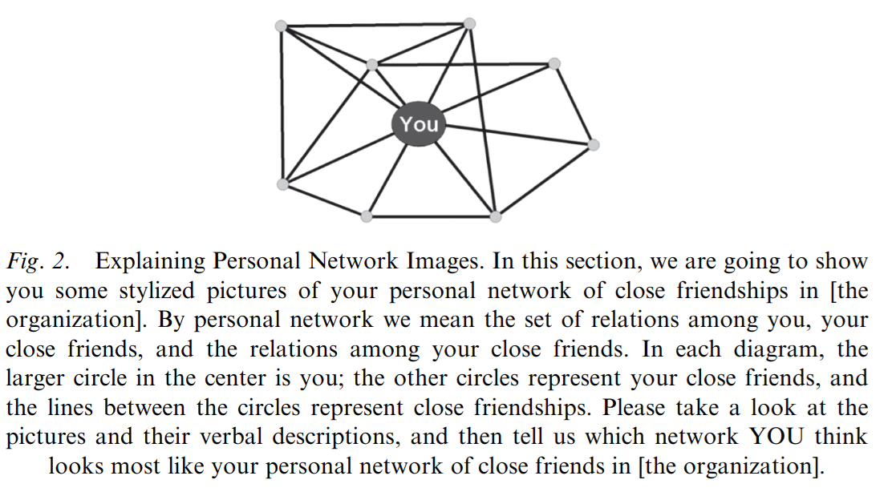
Alternatives: Visual network scales
We may be interested in the ways individuals perceive their position in a social network
  Visual network scales have been proposed as a viable method for this purpose
  The idea is to:
    Present people with idealized pictures of certain network scenarios
    Ask them to rate how closely their network resembles this scenario

Slide 30
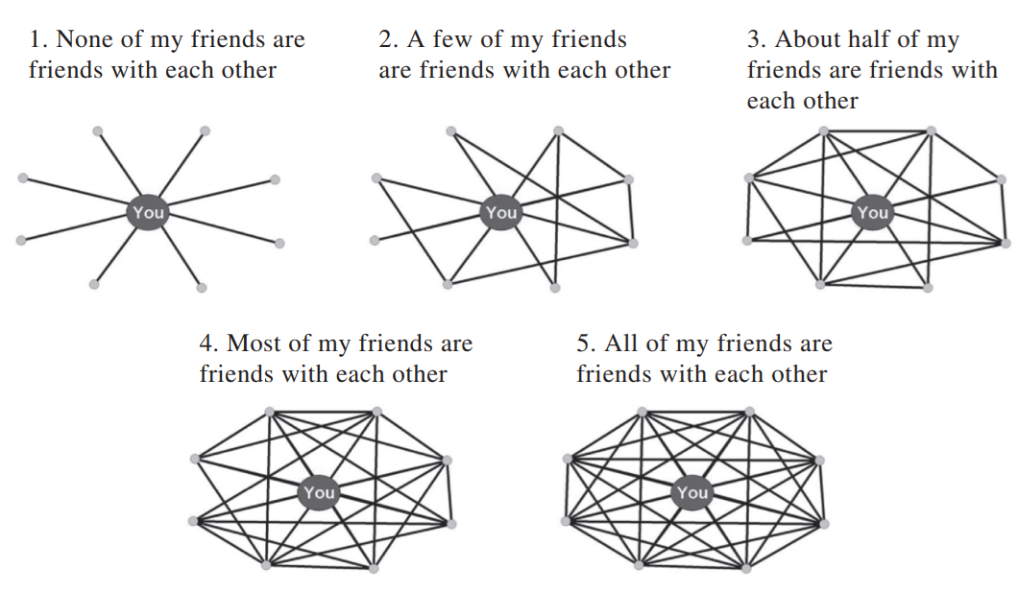
Alternatives: Visual network scales
For instance, we may be interested in whether people think they live in open versus clustered worlds:
  This question focuses on your perceptions of the degree of interconnectedness among your close friends at Notre Dame. In your opinion, which of the network diagrams below best approximates the degree of interconnectedness in your personal network of close friendships? Please make your selection by choosing one of the pictures.

Slide 31
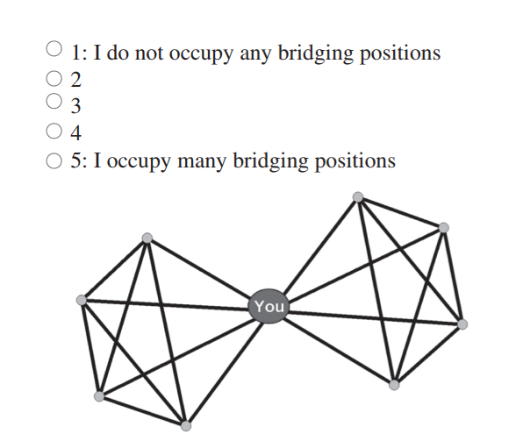
Alternatives: Visual network scales
For instance, we may be interested in whether people think they are bridges between different groups:
  In the diagram below, there are two groups of people. The large circle that connects the two groups/cliques can be thought of as a bridge. Using the scale below, please rate the extent to which you think you occupy a bridging position in your personal network of close friendships at Notre Dame i.e., the extent to which, like the "you circle," you are close friends with groups that otherwise lack close friendship relations with each other.

Slide 32
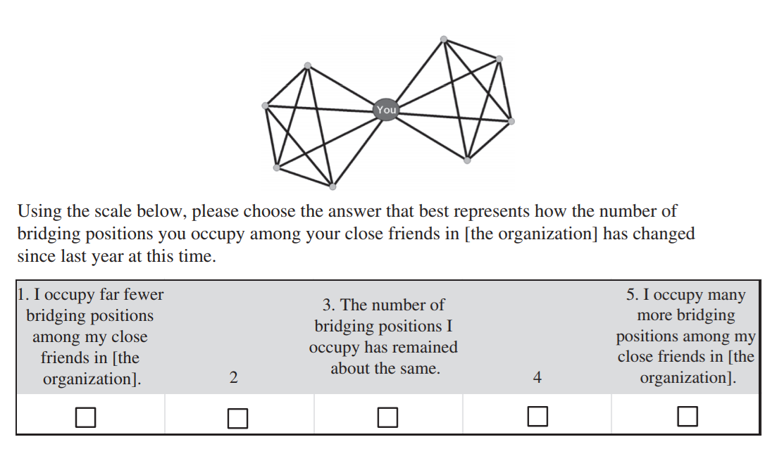
Alternatives: Visual network scales
We may also be interested in perceptions of social network position change over time:
  This question focuses on your perceptions of the CHANGE in the number of bridging positions you occupy among your close friends at Notre Dame. In the diagram below, there are two groups/cliques of people. The large circle that connects the two groups/cliques can be thought of as a bridge.

Slide 33
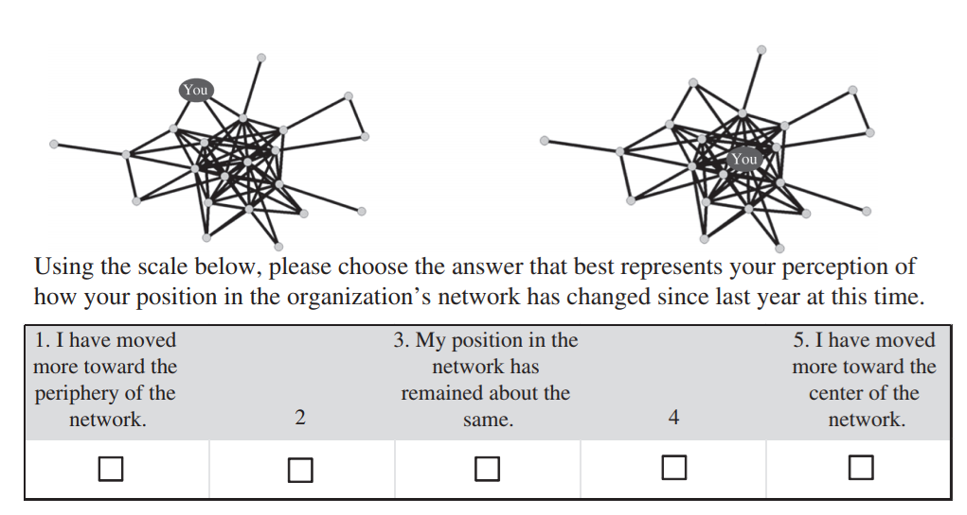
Alternatives: Visual network scales
We may also be interested in perceptions of social network position change over time:
  The network diagram on the left represents a person on the periphery of the network. This person has close friends who themselves are not connected to many others. The network diagram on the right represents a person in the center of the network. This person has close friends who themselves are connected to many others.

Slide 34
Name interpreters: Measuring Tie Strength
Most important tie-level measure for ego-networks is tie-strength:
  “The strength of a tie is a (probably linear) combination of the amount of time, the emotional intensity, the intimacy (mutual confiding), and the reciprocal services which characterize the tie” (Granovetter 1973, p. 1361).
    Strong ties combine frequency, exchanges, and positive sentiments
Note that most name-generators condition on or truncate the variance of strength in elicited ties
  Name generators are likely to elicit strong ties but not “weak ties”
    You may get the most variance by conditioning on frequency and then creating additive scales combining emotional intensity, intimacy, and exchange support indicators

Slide 35
Measuring “social capital” in ego-networks
Often we are interested in eliciting ego-networks to get a sense of how “well-connected” the person is
  One criterion for being well-connected is the extent to which a person can potentially draw on resources embedded in relations
    This is called “social capital”
    Natural outgrowth of the exchange approach
  Invites a different measurement perspective

Slide 36
Ego networks: Some propositions (Marsden 1987)
The larger the ego network:
  The more diverse, less homophilous, more open
Smaller ego networks:
  Tend to be more clustered , less diverse
The more diversity
  Less homophily
The higher average tie strength
  The more clustering, less diversity
The more proportion kin
  The more homophily, less diversity, more clustering

